Slide 1
HyPar: Towards Hybrid Parallelism for Deep Learning Accelerator Array
2019 HPCA

Slide 2
Target
The optimization target is to search a partition that minimizes the total communication during training a complete DNN
Determine layer-wise parallelism for DNN training

Slide 3
Parallelism
Data Parallelism: all accelerators hold a copy of model, but data(training samples) are partitioned into parts and each accelerator process one part
Model parallelism: all accelerator process on the same data (training samples), but the whole model is partitioned and each accelerator holds a part of the model

Slide 4
Communication Model
Question: for an accelerator and various parallelism settings, where does the communication come from, and what is the amount of communication?

Slide 5
Two types of parallelism
data parallelism: all accelerators have a copy of kernel(weight) of one specific layer, while feature maps associated with that layer are partitioned
model parallelism: the kernels(weights) of one specific layer are partitioned and each accelerator has one partition
Ex: 2 accelerators, the batch size is B = 32, FC, input neuron:70, output neuron: 100

Slide 6
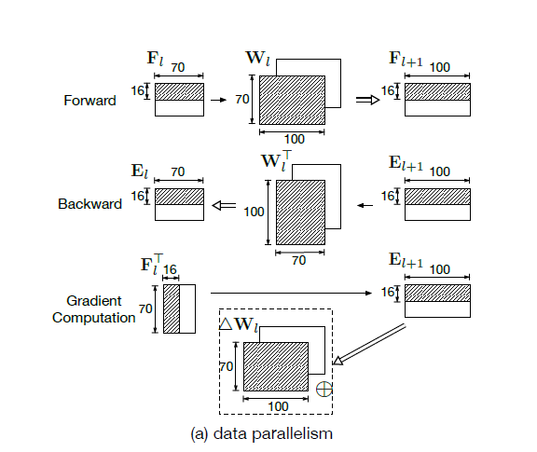
data parallelism: each accelerator holds one part of the partitioned data and a complete copy of the kernel
Only kernel updating(Gradient Computation) needs data communication across accelerators

Slide 7
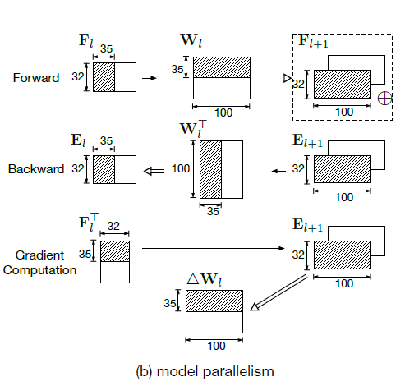
model parallelism: the kernel is partitioned, and feature maps are partitioned accordingly.
Only forward needs data communication across accelerators

Slide 8
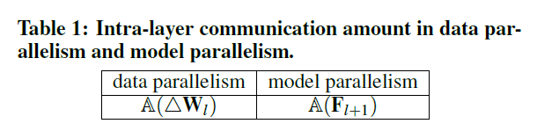
intra-layer communication by kernel updates within a layer

Slide 9
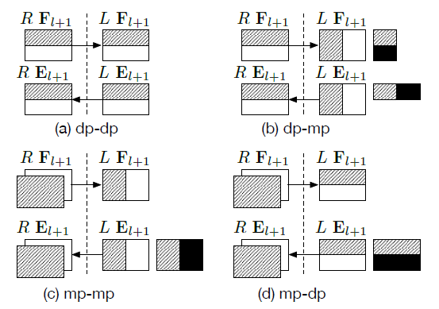
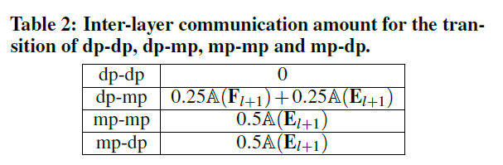
inter-layer communication: dp-dp dp-mp mp-mp mp-dp
due to accessing feature maps and errors conversion of L and R

Slide 10
From Table 1 and Table 2, we can see that, for DNN inference, the best option is Data Parallelism, i.e., data parallelism for every layers. (no gradient computation is necessary)

Slide 11
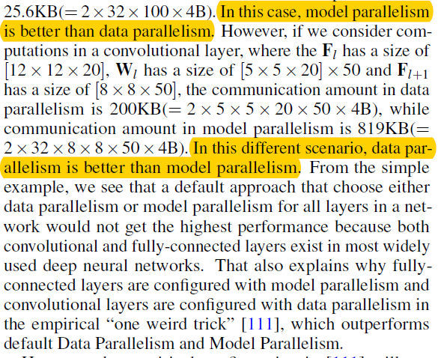
However, the assumption is different for DNN training, and parallelism becomes a critical concern
Just considering intra-communication:
FC → model parallelism
CONV → data parrallelism

Slide 12
Short summary:
1) each layer is configured with either data parallelism or model parallelism
2) the calculation for inter-layer communication only depends on two adjacent layers
3) the intra-layer communication only depends on the parallelism of that layer, but does not depend on any other layer

Slide 13
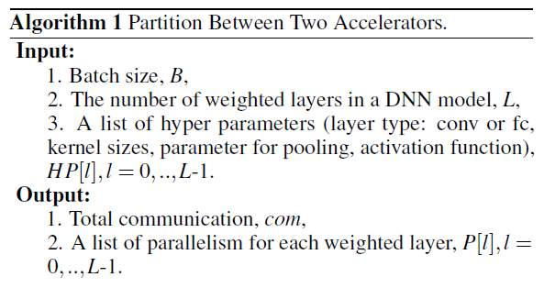
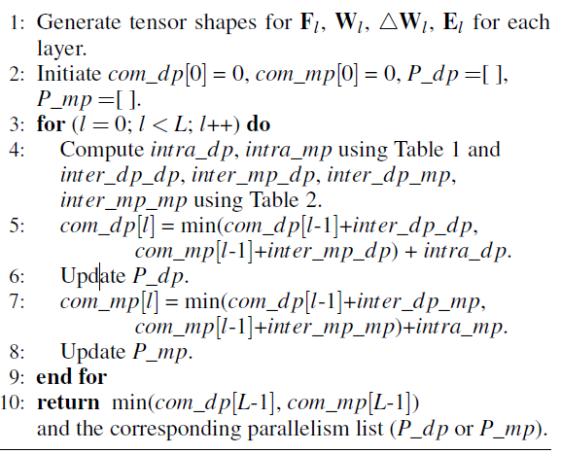
Algorithm 1: Partition Between Two Accleratos

Slide 14
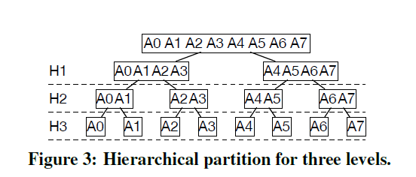
Hierarchical Partition(an array of accelerators)
Binary structure
Recursive

Slide 15
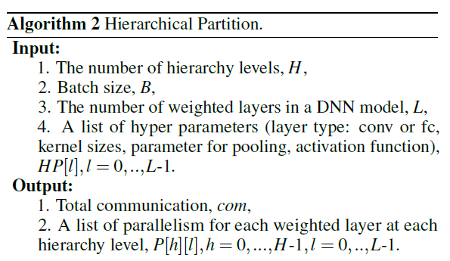
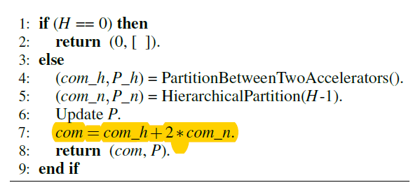
Algorithm 2 Hierarchical Partition

Slide 16
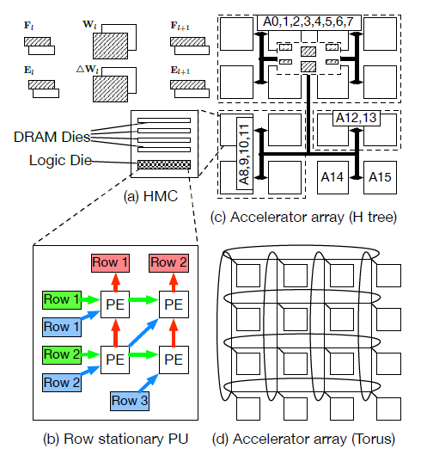
Hypar Architeture
H tree √

